Slide 1
SIL Working Group on Aquatic Invasive Species
36th SIL Congress
7-10 August 2022
Berlin, Germany
SIL Working Group on Aquatic Invasive Species: history and current activities
Vadim E. Panov
Regional Euro-Asian Biological Invasions Centre (REABIC), Finland

Slide 2
SIL Working Group on Aquatic Invasive Species
36th SIL Congress
7-10 August 2022
Berlin, Germany
SIL Working Group on Aquatic Invasive Species
http://www.reabic.net/SIL.aspx
The Working Group was established in August 1998
at the 27th SIL Congress in Dublin, Ireland
The long-term goal of the Working Group is to promote global awareness of the problems and risks posed by cross-boundary species transfers by encouraging and improving scientific networking and data exchanges

Slide 3
SIL Working Group on Aquatic Invasive Species
36th SIL Congress
7-10 August 2022
Berlin, Germany
SIL Working Group on Aquatic Invasive Species
http://www.reabic.net/SIL.aspx
Suggested initial key activities of the Working Group:
To develop an international network of interested scientists and decision-makers concerned about aquatic invasive species, using the Internet as a primary vehicle of communication;
To encourage and seek support for development of an international database on AIS;
To support/organize thematic international meetings
http://www.reabic.net/SILannouncing.aspx

Slide 4
SIL Working Group on Aquatic Invasive Species
36th SIL Congress
7-10 August 2022
Berlin, Germany
SIL Working Group on Aquatic Invasive Species
http://www.reabic.net/SIL.aspx
The Working Group meetings and special sessions,
related to SIL Congresses:
August 11, 1998, Dublin, Ireland : SIL WG AIS Workshop
"Aquatic Invasive Species – Developing a Scientific Information Exchange“
August 13, 2004, Lahti, Finland: SIL WG AIS Workshop
"Aquatic Alien Species – International Cooperation in Research, Information
Exchange and Management“
August 12-18, 2007, Montreal, Canada: Special session “Ecology and
Ecotoxicology of Invasive Species in Inland Waters” (special issue of AI)
August 31, 2016, Torino, Italy: Special session “Alien species ecological impacts:
from genomics to macroecology” (special issue of AI)
August 24, 2021, Gwangju, Republic of Korea: SIL WG AIS Meeting
August 8, 2022, Berlin, Germany: Special session “Invasive alien species
in inland waters: invasion trends, impacts and management”

Slide 5
SIL Working Group on Aquatic Invasive Species
36th SIL Congress
7-10 August 2022
Berlin, Germany
SIL Working Group on Aquatic Invasive Species
http://www.reabic.net/SIL.aspx
The Working Group initiatives:
2001 - establishment of European Information and Research Network
on Aquatic Invasive Species (ERNAIS)
2006 - establishment of open access international journal Aquatic Invasions
2012 - establishment of open access international journal BioInvasions Records
2013 - development of new concept and new editorial team of open access
international journal Management of Biological Invasions
2016 - start of the International Association for Open Knowledge on Invasive
Alien Species (INVASIVESNET) initiative – publication of INVASIVESNET
concept paper in Management of Biological Invasions
2017-2018 - launch of INVASIVESNET website and formal establishment of this
new thematic association

Slide 6
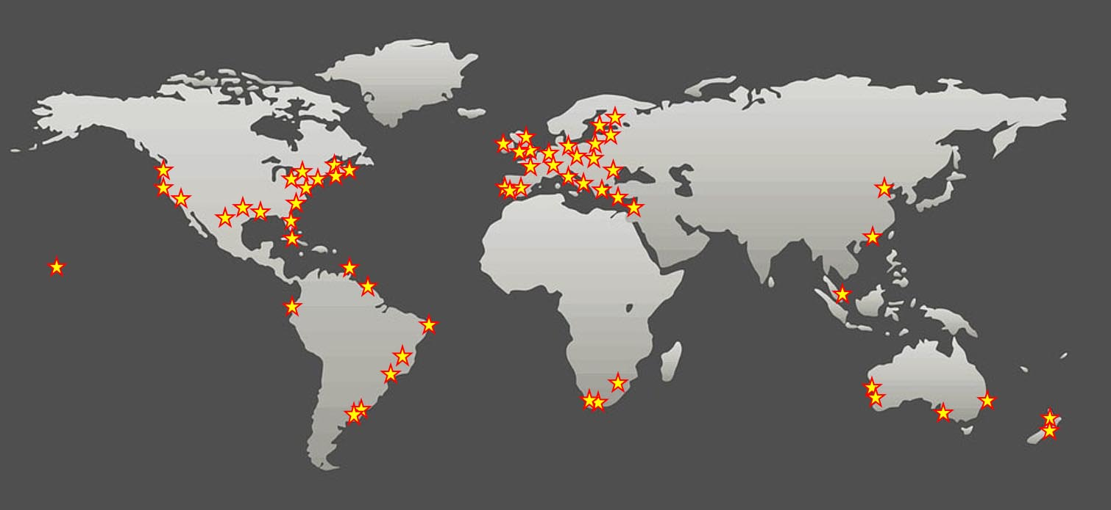
Official Journals of INVASIVESNET:
Aquatic Invasions, BioInvasions Records and Management of Biological Invasions
Supported by the global international network of editors
AI – 58 editors, BIR – 88 editors, MBI – 47 editors

Slide 7
SIL Working Group on Aquatic Invasive Species
36th SIL Congress
7-10 August 2022
Berlin, Germany
Number of published papers (per year)
201
Support from ALARM
EnviroGRIDS
Payments by authors
INVASIVESNET open access publishing fund

Slide 8
SIL Working Group on Aquatic Invasive Species
36th SIL Congress
7-10 August 2022
Berlin, Germany
How you can contribute to SIL WG AIS and INVASIVESNET activites?
Consider publishing your research on AIS in open-access INVASIVESNET journals – e-mail to vepanov@gmail.com
Join INVASIVESNET as an individual or organisional member, create your personal online INVASIVESNET expert profile, and express your interest in reviewing and/or editorial work
Share information on your AIS-related research activities with colleagues via INVASIVESNET social media – e-mail to media@invasivesnet.org

Slide 9
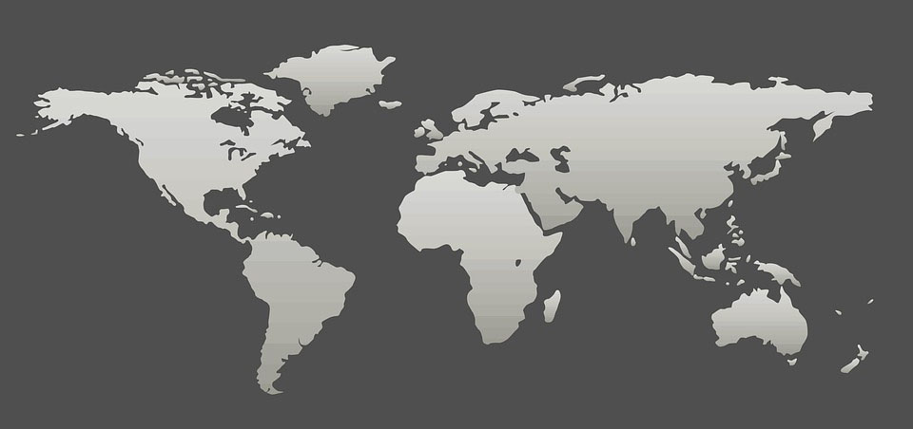
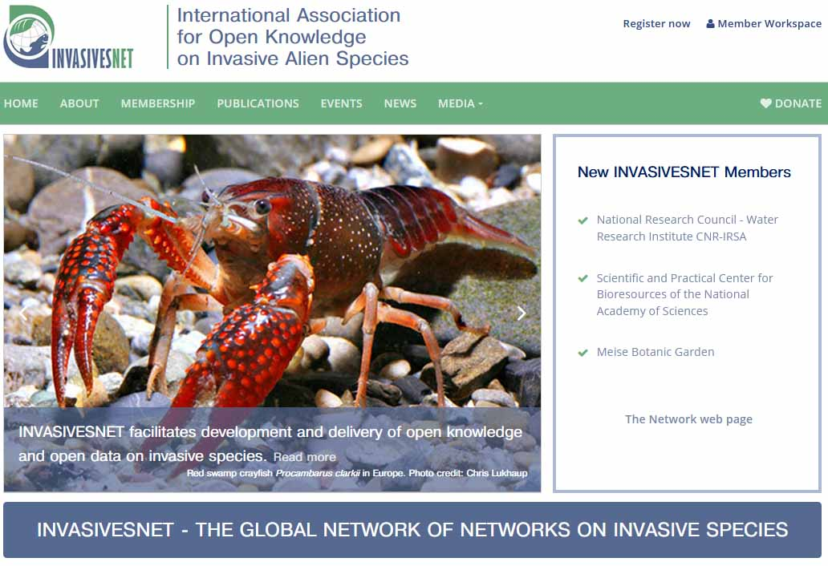
INVASIVESNET website
SIL Working Group on Aquatic Invasive Species
36th SIL Congress
7-10 August 2022
Berlin, Germany
https://www.invasivesnet.org

